Slide 1
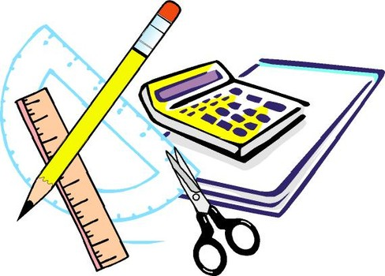
Learning Objective
I will use calculate indices using times tables and my calculator.
Enter quietly, please be ready with the following on your desk:
Whiteboard
Whiteboard marker
Exercise Book
Pencil, pen, ruler and red pen
Diary
Calculator
Device – charged or borrowed from Library before maths

Slide 2
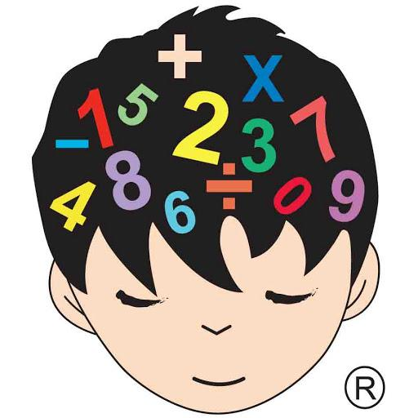
Daily Review
CFU
What does the commutative law state?
Commutative law – the order in which I add or multiply any two numbers does not change the answer
5 x 7 = 35
7 x 5 = 35
7 + 8 = 15
8 + 7 = 15

Slide 3
Daily Review
CFU
What does the associative law state?
Associative law – the order in which 3 or more numbers are added or multiplied, does not change the results
2 x 3 x 5 = 30
3 x 5 x 2 =30
6 + 7 + 8 = 21
6 + 8 + 7 = 21

Slide 4
Daily Review
CFU 1
What is the distributive law
Distributive law – we split large numbers into 1s, 10s and 100s
Whiteboards
CFU 2
57 x 8
What does the distributive law involve?
4 x 55
= 8 x (50 + 7)
= 8x50 + 8x7
CFU 3
How can I split 18?
= 400 + 56
CFU 4
= 456
How can I split 56?

Slide 5
Daily Review
Use the ‘make easy numbers’ strategy
Whiteboards
293 + 569
325 + 297
= 293 + 7 + 562 (take the 7 from 569)
= 300 + 562
= 862

Slide 6
Daily Review
Use the ‘make easy numbers’ strategy
Whiteboards
4 x 42 x 5
2 x 16 x 5
= 4 x 5 x 42 (swap 5 and 42)
= 20 x 42
= 840

Slide 7
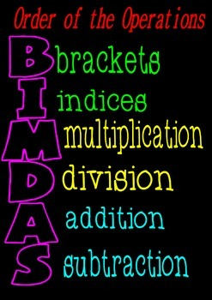
Learning Objective
CFU
What will we learn today?
CFU
I will calculate indices using times tables and my calculator.
How will you know that you are successful?
Success Criteria
At the end of the lesson, I will be able to:
Use index form and expanded form.
Calculate an index.
Find the squared, square root and exponent buttons on my calculator.

Slide 8
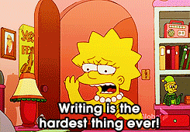
Activate Prior Knowledge
Mathematicians are lazy and hate writing more than is necessary.
Which would take longer to write out?
5 x 5 x 5 x 5 x 5 x 5 x 5 x 5 x 5 x 5 x 5 x 5
OR
5¹²

Slide 9
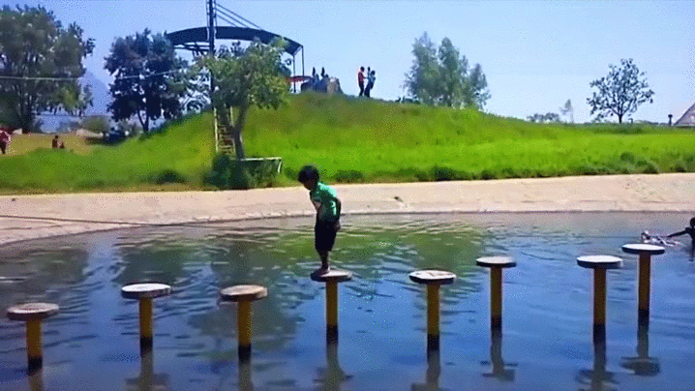
Relevance
Learning about indices is a stepping stone on to many useful mathematical concepts including:
Measuring area.
Measuring volume.
Scientific notation.

Slide 10
Concept Development
CFU
Why do we use index notation?
Index notation – to save space when repeating a number multiplied by itself, mathematicians write in index form.
CFU
In 7⁸ what is the base?
5
INDEX or POWER
4
BASE
CFU
In 7⁸ what is the power?
4⁵ = 4 x 4 x 4 x 4 x 4 = 1,024
Index Form
Expanded Form
Answer

Slide 11
Skill Development
VOCABULARY
Index Form – Simplified into a base and power
(e.g. 7³).
Write the following in expanded form:
7³
VOCABULARY
7³
= 7 x 7 x 7
2⁴
= 2 x 2 x 2 x 2
Expanded Form – Showing all of the multiplications
(e.g. 7 x 7 x 7).
6³
= 6 x 6 x 6
58²
= 58 x 58
Write the following in index form:
3 x 3 x 3 x 3
= 3⁴
5 x 5 x 5 x 5 x 5
= 5⁵
92 x 92
= 4³ x 7
= 92²
4 x 4 x 4 x 7

Slide 12
Skill Development
Whiteboards
Write the following in expanded form:
5³
8⁴
2⁵
67²
Write the following in index form:
4 x 4 x 4 x 4
11 x 11 x 11 x 11
73 x 73 x 73
5 x 5 x 5 x 5 x 7 x 7

Slide 13
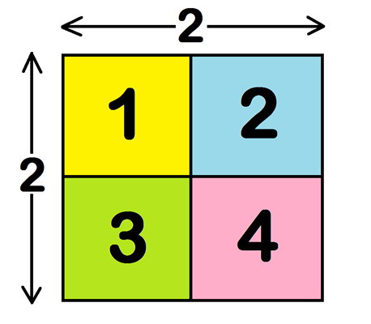
Concept Development
CFU
What is a square?
Squares – A square is the result of a number multiplied by itself. Its symbol is ².
CFU
Why do we call it a square?
2² = 2 x 2 = 4 2.5² = 2.5 x 2.5 = 6.25 16² = 16 x 16 = 256
CFU
Is 9 a square number?
SQUARE
CFU
To calculate the area of a square shape, you multiply the side length by itself. We therefore call multiplying a number by itself ‘squaring’ a number, and we measure area in square units.
Is 8 a square number?

Slide 14
Skill Development
VOCABULARY
Square – the result of a number multiplied by itself.
(e.g. 2 x 2 = 4).
A square is the result of a number multiplied by itself.
Which of these are squares?
2 x 8 = 16 4.8 x 4.8 = 23.04 42 x 42 = 1764
0.04 x 0.04 = 0.0016 28 x 29 = 812

Slide 15
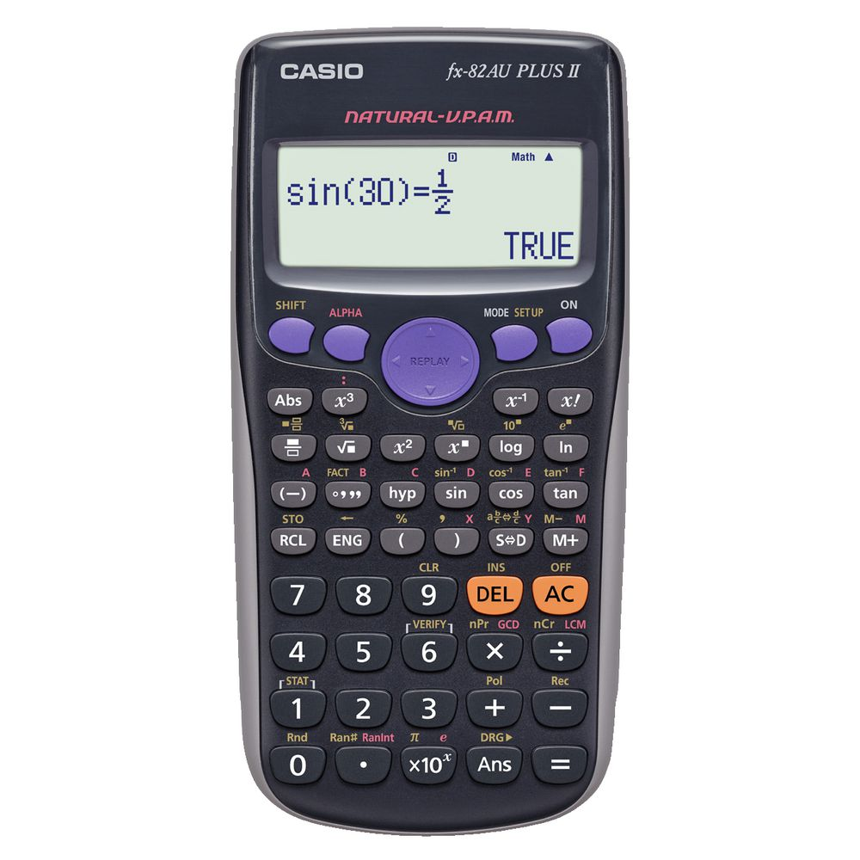
On Your Calculator
^
x²
OR
2
You might need to press shift first
58²
= 3,364

Slide 16
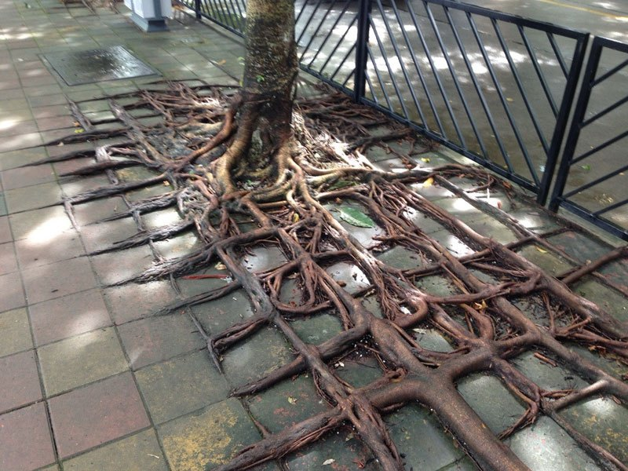
Concept Development
CFU
What is a square root?
Square Root – Square rooting a number is the opposite of squaring a number. Its symbol is √.
√ 100 = 10 √64 = 8
√36 = 6 √16 = 4
√4 = 2 √6.25 = 2.5

Slide 17
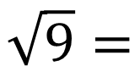
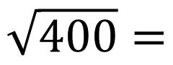
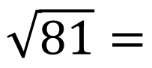
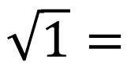
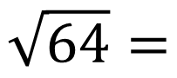
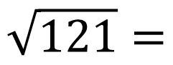
Questions
Whiteboards
Calculate the following:
$$\sqrt{81}=$$
$$\sqrt{64}=$$
$$\sqrt{9}=$$
$$\sqrt{1}=$$
$$\sqrt{121}=$$
$$\sqrt{400}=$$

Slide 18
On Your Calculator
√x OR √
You might need to use brackets.
√5,184
= 72

Slide 19
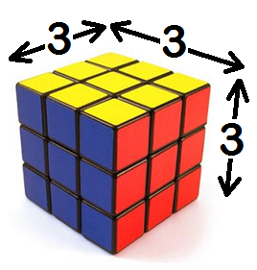
Concept Development
CFU
What is a cube?
Cubes – A cube is the result of a number multiplied by itself three times. Its symbol is ³.
CFU
Why do we call it a cube?
3³ = 3 x 3 x 3 = 27 2.5³ = 2.5 x 2.5 x 2.5 = 15.625
CFU
Cubes
Is 8 a cubed number?
CFU
To calculate the volume of a cube, you multiply the side length by itself 3 times. We therefore call multiplying a number by itself 3 times ‘cubing’ a number, and we measure volume in cubed units.
Is 9 a cubed number?

Slide 20
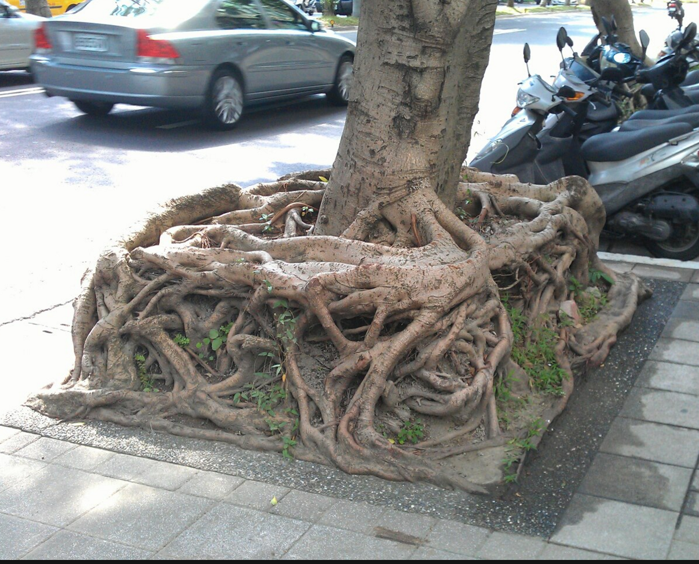
Concept Development
CFU
What is a cube root?
Cube Root – Just like square roots, cube rooting a number is the opposite of cubing a number. Its symbol is ³√.
³√8 = 2
³√729 = 9
³√1728 = 12

Slide 21
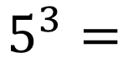
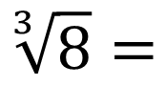
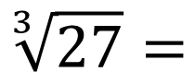
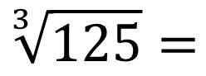
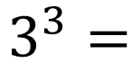
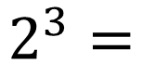
Questions
CFU
Whiteboards
What link do you see between cubes and cube roots?
Calculate the following:
$$\sqrt[3]{27}=$$
$$3^{3}=$$
$$5^{3}=$$
$$\sqrt[3]{125}=$$
$$2^{3}=$$
$$\sqrt[3]{8}=$$

Slide 22
On Your Calculator
x
OR
^
OR
x^{y}
You might need to press shift first
8⁶
= 262,144

Slide 23
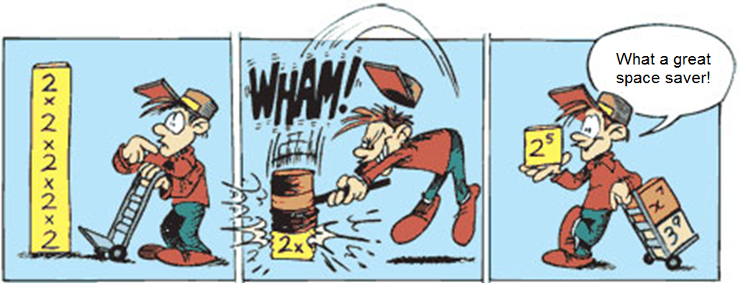
Skill Closure
What have we learnt today?
Lesson Objectives:
I will calculate indices using times tables and my calculator.
6² = ?
= 6 x 6
= 36

Slide 24
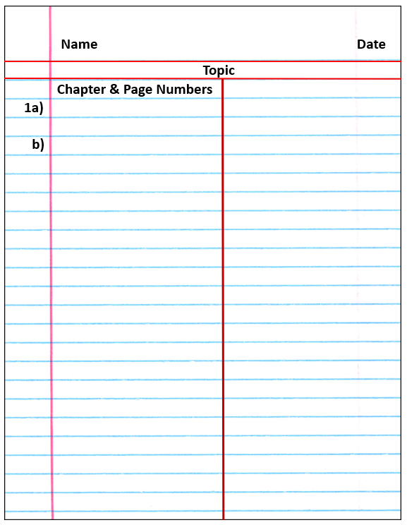

Independent Practice
Mathematics Page Layout
Open your textbooks to:
Chapter 1.2
Questions: 1 – 5 (1 column), 8 (1 column), 6, 9, 11

